Slide 1
ETCH TB Library Summary
----Arcing

Slide 2
TB Library Summary
TB Library 主要从以下几方面阐述：
失效机理
鱼骨图
具体案例
解决方案

Slide 3
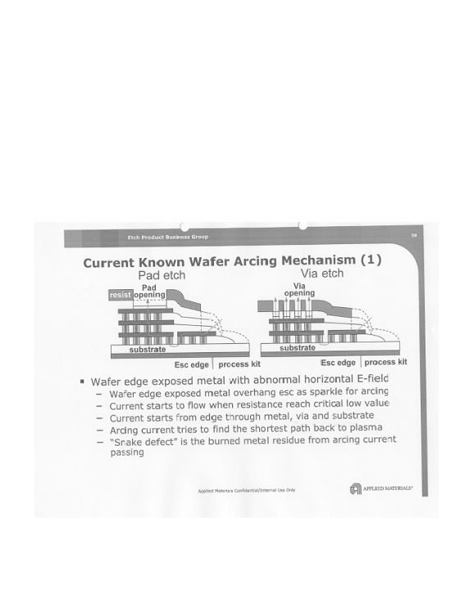
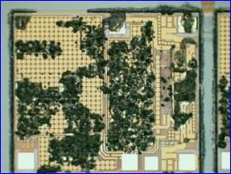
Arcing 失效机理
Arcing 主要由以下一种或几种失效机理产生:
后段特殊的MIM结构: Backend structure especially with MIM layer is easy to collect electron and electron current will induce arcing.
Wafer edge exposed metal with abnormal horizontal E-field
Wafer edge exposed metal overhang esc as sparkle for arcing
Current starts to flow when resistance reach critical low value
Current starts from edge through metal, via and substrate
Arcing current tried to find the shortest path back to plasma
“Snake defect” is the burned metal residue from arcing current passing
Chamber polymer peeling into plasma, polymer表面吸附大量电荷局部电压过大引发arcing.
Chamber RF system not stable, plasma unstable induce arcing.

Slide 4
Arcing 鱼骨图
Material
Machine
7
5
8
Incoming wafer: charging
Tool type difference
Parts damage
9
Gas purity
6
10
1
Chemical Conc.
Chamber peeling
11
2
Wafer edge metal exposure
3
N2 Purge
Arcing
4
12
Temp
Etch recipe
(power magnet transition)
13
Asher Temp.
14
WET clean/ Scrubber
Q-time
Baking
(Before or post)
15
Humidity
Process by product metal element
16
Environment
Method

Slide 5
Arcing 解决方案
从其失效机理来分析，Arcing 的解决方案主要为:
MIM structure is easy to collect electron and electron current will induce arcing.
Reduce VIA etch OE step RF power, magnet intensity.
Chamber polymer peeling into plasma, polymer表面吸附大量电荷局部电压过大引发arcing.
Control cathode/wall liner roughness, reduce polymer peeling probability
Chamber RF system not stable, plasma unstable induce arcing.
Check chamber RF system include RF generator, RF match, RF cable, magnet driver etc
Tighten RF related IEMS parameter (RF forward mean, dev, RF reflect mean dev etc）
Recipe optimization to keep stable plasma environment

Slide 6
Thank You

Slide 7
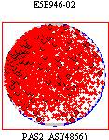
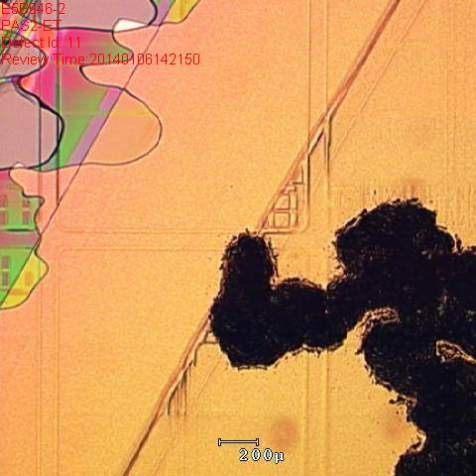
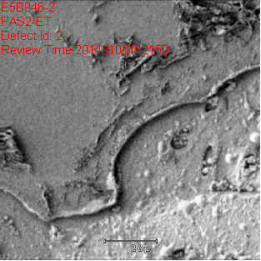
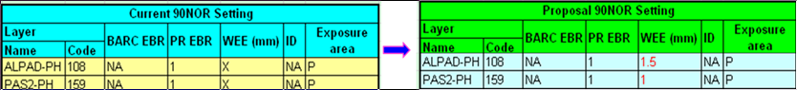
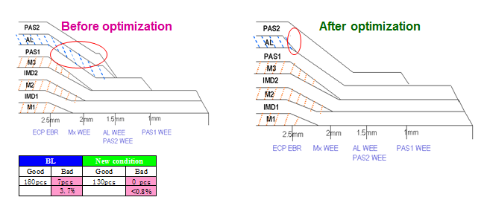
Case 1: B1 EEOXA11_AC Wafer Arcing
Issue Description:
90Nor suffered 3pcs wafer arcing in producer chamber(EEOXA11_A 2pcs (E5B946#02 4464; E5E060#03 4395) EEOXA11_C 1pcs (E5B998#04 4464).
Root Cause:
WEE AL exposure caused by 90Nor wafer edge baseline compile with EPILS01 condition worse.
Solution: WEE optimization. PIE 2/15
7

Slide 8
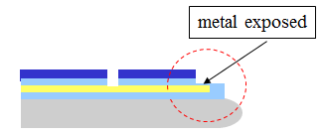
Case 2: B1 Wafer Edge W Induced Arcing
Issue Description:
From 9-24 to now, total 5pcs (E5Q929 #22/ E5P997 #13#19#23 /E5Q912 #2 ) suffered arcing issue and defect high at V1OX-ET
Root cause: Suspect W remain at wafer edge, lead to micro-arcing after main etch
Solution:
TF check ETWDP02_B. TF

Slide 9
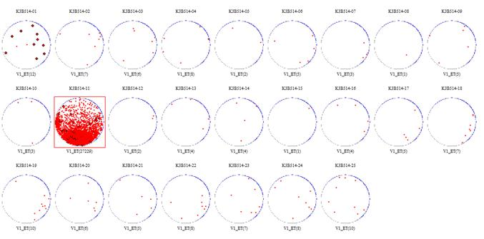
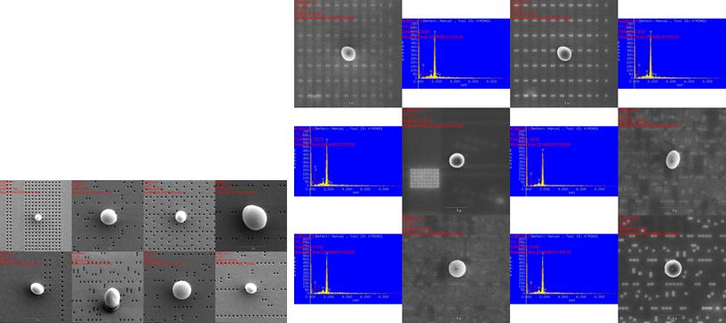
Case 3: F8 Vx ET wafer edge W arcing
Issue Description:
Vx ET suffer wafer edge W arcing defect.
IEMS&DA can not getting.
Root Cause:
W DEP condition NG, dedicate to W EDP worse chamber.
Action:
Constrain W DEP worse chamber.
Ball defect
EDX 10000V
W peak

Slide 10
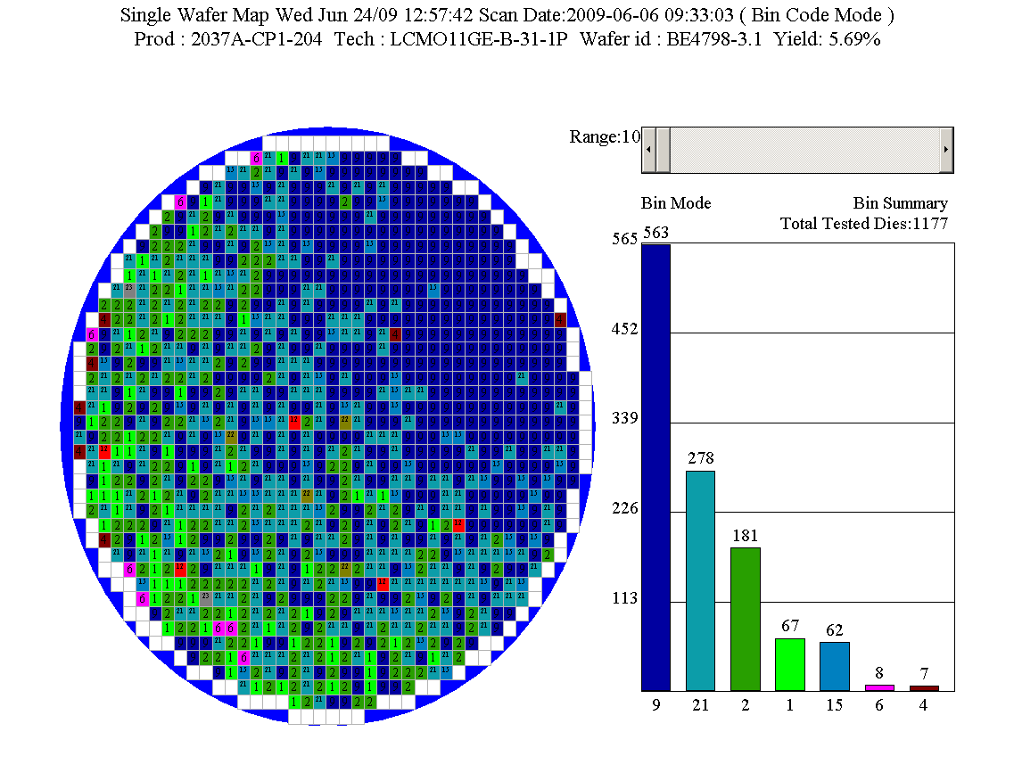
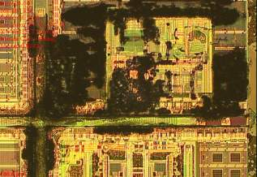
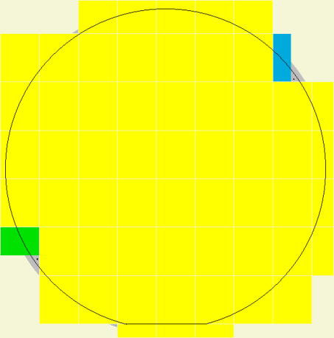
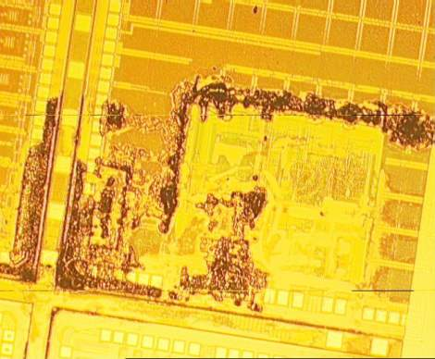
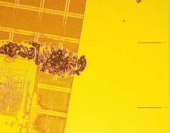
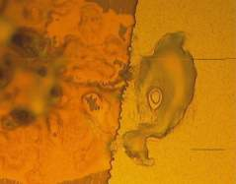
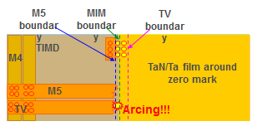
Case 4: S1 D13 2037 Via Arcing
Issue description:
2037 15pcs wafer from 14 lots suffered SWLY with same pattern from 2008/11/25, by wafer yield loss 75%~100%,
Arcing take place during V7OX_ET, arcing source all from PHOTO zero mark area
Root cause:
Arcing happen during V7 etch through TaN/Ta film and wide M5 at the boundary between M5 & MIM PHOTO REMA shielded area.
Solution:
Change MIM_PHOTO process to expose the area around zero mark
Partial die
TaN/Ta film
M5 Cu
TaN/Ta
Arcing source!!!

Slide 11
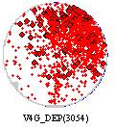
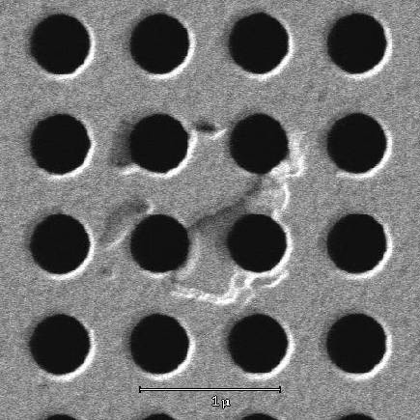
Case 5: F7 TEL TV-ET suffer arcing defect
Issue Description:
18MS TV-ET suffer arcing defect if there is MIM layer under TV
Root Cause:
There is permanent magnet on TEL DRM, so the plasma density is stronger than eMax(magnet can be turned off), which lead to wafer arcing.
Solution:
Constraint all TV-ET on TEL for all flow which had MIM structure

Slide 12
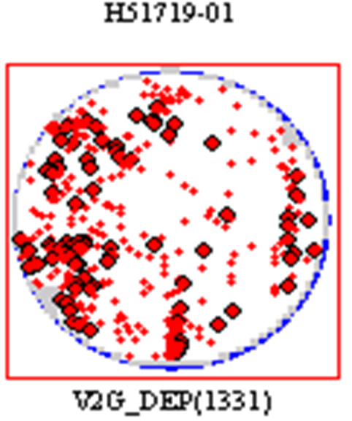
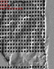
Case 6: F7 EMAX polymer peeling arcing
Issue Description:
18MS TV-ET suffer arcing defect if there is MIM layer under TV
Root Cause:
Chamber polymer peeling into plasma, polymer表面吸附大量电荷局部电压过大引发arcing.
Solution:
Control cathode/wall liner roughness, reduce polymer peeling probability

Slide 13
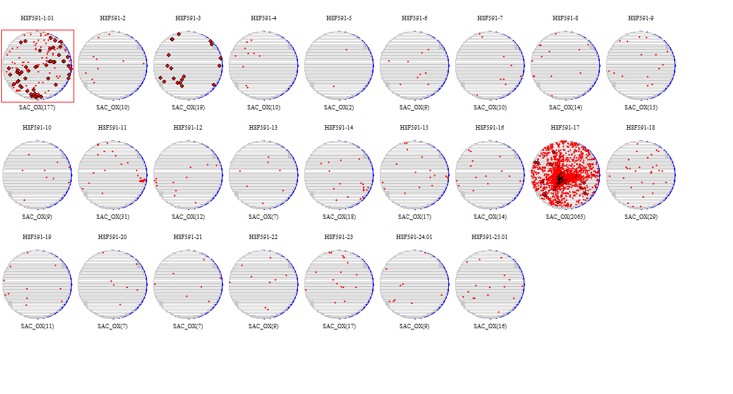
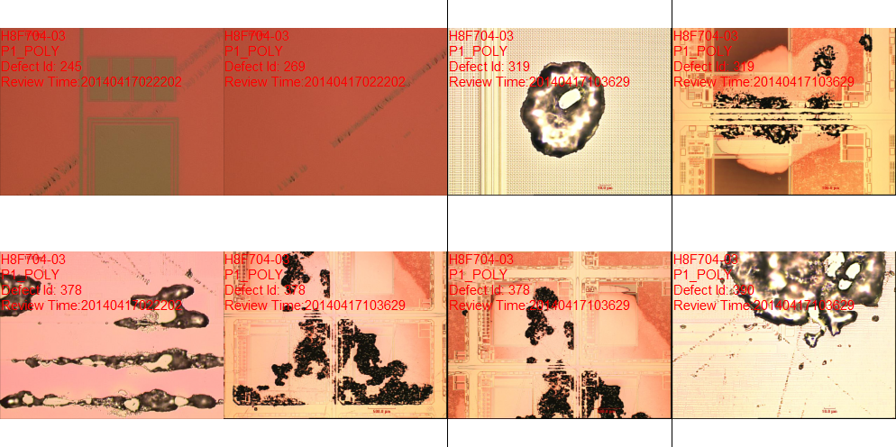
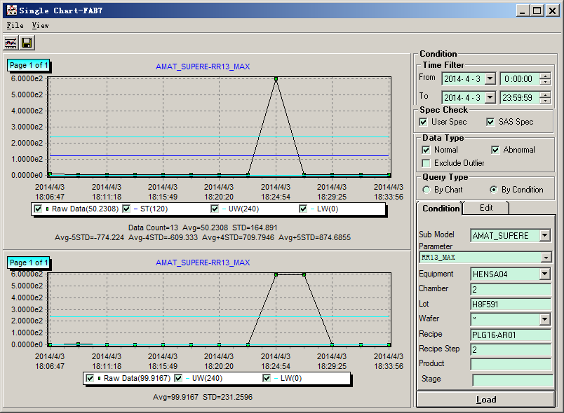
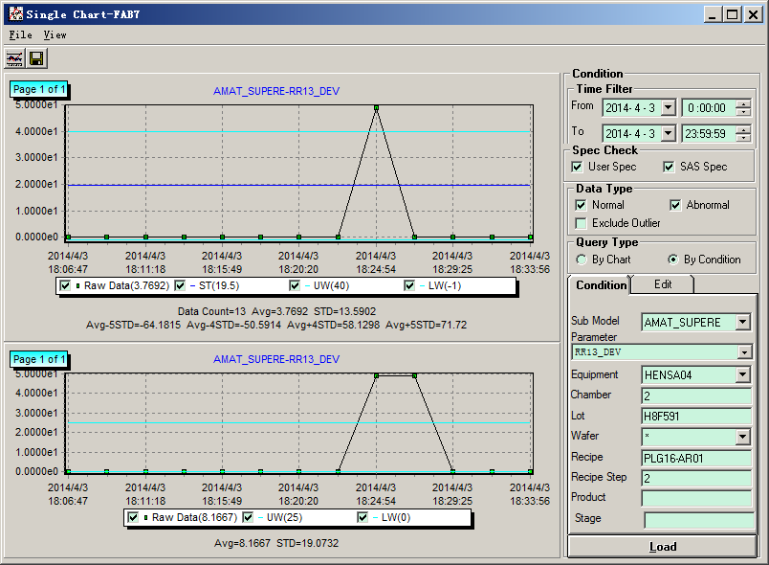
Case 7: F7 Super-e AR ET arcing
Issue Description:
AR ET suffer arcing defect .
Some impact wafer RR13_MAX and RR13_DEV jump
Root Cause:
Chamber RF system not stable, plasma unstable induce arcing.
Solution:
Change RF generator
Tighten RR13_MAX and RR13_DEV limit.

Slide 14
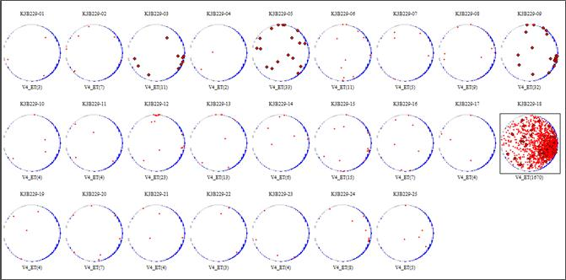
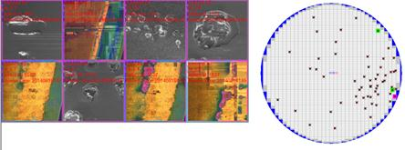
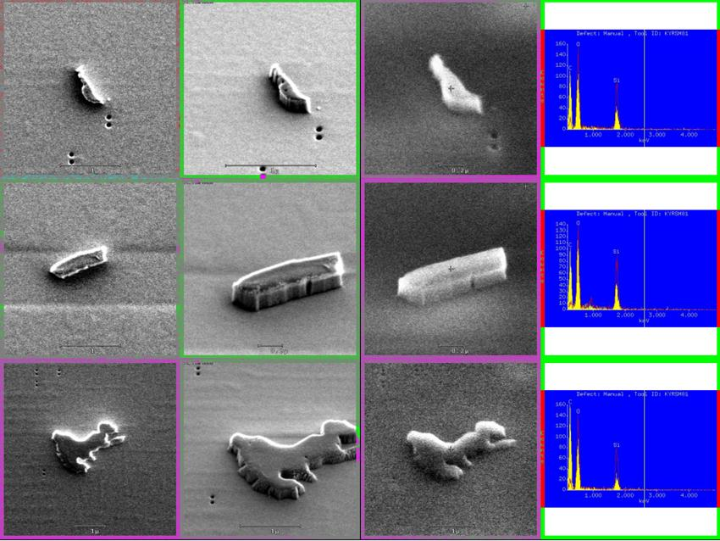
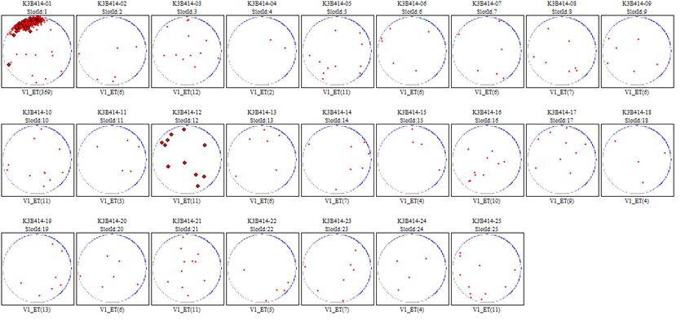
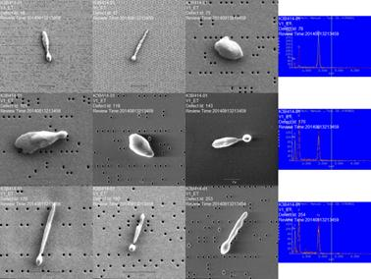
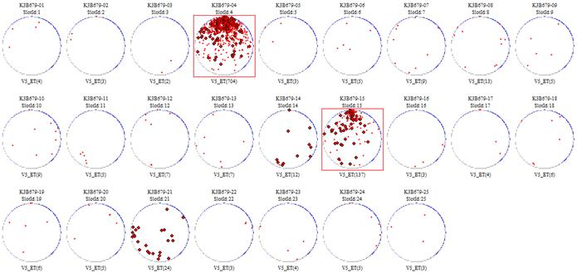
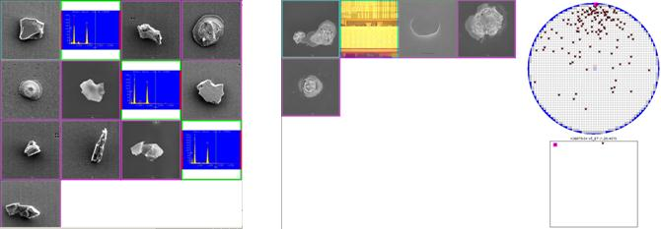
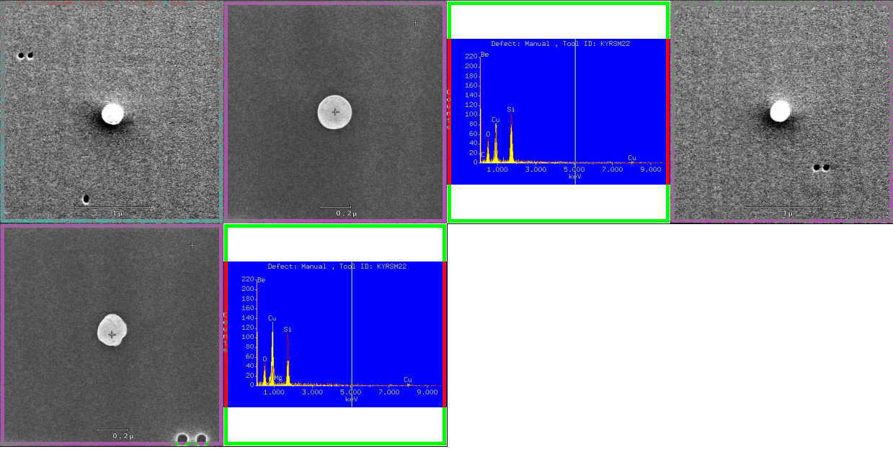
Case 8: F8 Vx ET wafer edge arcing
Issue Description:
Vx ET suffer wafer edge CU arcing and SI/O arcing. (residue type or surface type)
IEMS&DA can not getting.
Resiude 1
Root Cause:
Not clear, suspect wafer edge condition NG
Containment Actions:
Tighten chamber RF time
Survey install 2 stage pin follow WW
Resiude 2
Surface PD
CU peak

